Slide 1
Building Web Applications with Python
Part 1 - HTML

Slide 2
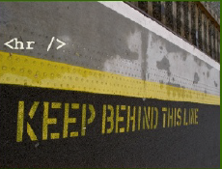
What is HTML?
Hyper Text Markup Language.
HTML is a computer language that is used to create documents on the World Wide Web.
HTML is very simple, and logical.
It reads from left to right, top to bottom and uses plain text.
HTML is NOT a programming language, but a mark-up language that uses <Tags> like this.
The websites you view on the internet are actually text files that consist of HTML Tags.

Slide 3
Advantages of knowing HTML Code
New technologies start out as code without tools
HTML (early days), JavaScript, Java, ASP, XML
Even if you use WYSIWYG editors, it helps to know HTML code to insert ASP or JavaScript into a HTML file
If you can read code, you can copy clever ideas from others (within reason and the law). Imitation is the best form of flattery.
Go to any web page, click on “View” “Page source” or “Source” and the HTML code used to create that web page can be studied, or just copied (within legal and copyright bounds)
Web authoring tools don’t give as much control.
Most web professional web designers use HTML .

Slide 4
HTML Issues for Organizations
Why the need to know HTML code?
WYSIWG (What You See Is What You Get) editors (like Front Page and Dreamweaver) create program-specific code that is incomprehensible to other programs and may not be displayed correctly on all browsers or all operating systems.
You cannot edit them if you don’t have the original software, OR know enough about HTML and how it works to be able to make small edits yourself.
Company Intranets mostly use HTML.
HTML is now also used in e-mail and in e-mail marketing.
HTML is increasingly used as the basis of stand-alone applications that use a GUI (Graphical User Interface). Eg., an online Calculator with input fields.

Slide 5
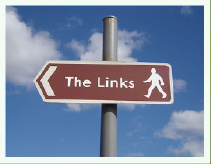
What is Hypertext?
Documents with links to other documents.
A non-sequential, non-linear method for reading a document.
Textual data which is linked within itself or across multiple documents or locations
A nonlinear system of writing that allows users to access text or a narrative through multiple pathways.

Slide 6
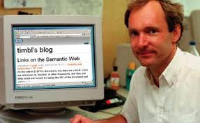
A very brief History of HTML
Tim Berners-Lee , a British physicist working at CERN labs in Switzerland at the time (1989) is the inventor of HTML, and is often also credited as the inventor of www.
HTML is based on SGML (Standard Generalized Markup Language), which existed since 1940s, but without the ability to link.
He proposed it as a way for of enabling researchers from remote sites in the world to organize and pool together information.
He suggested that you could actually link the text in the files themselves, through an agreed-upon mark-up language.

Slide 7
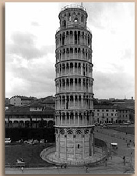
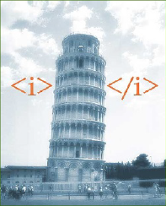
Now, what is a mark-up language?
A markup language identifies pieces of a document so that another person (or application) can do something with those pieces.
Before HTML After HTML

Slide 8
The W3C: A www Consortium
Today, the World Wide Web Consortium (W3C) is an international consortium where member organizations, a full-time staff, and the public work together to develop Web standards. Tim Berners-Lee is the Director of the W3C.

Slide 9

HTML is no different from any other formatting language.
HTML is NOT a computer programming language.
Neither is SQL or XML, although extensions to these languages can be computer languages.
Just as SQL is a data query language, HTML is simply a text-formatting language

Slide 10
HTML uses Tags to markup the text
Tags are instructions that tell your Web browser what to show on the page
A tag is always enclosed in angle bracket <> like <HTML>
HTML tags normally come in pairs like <HTML> and </HTML> i.e.
Start tag = <HTML>
End tag =</HTML>
Start and end tags are also called opening tags and closing tags

Slide 11
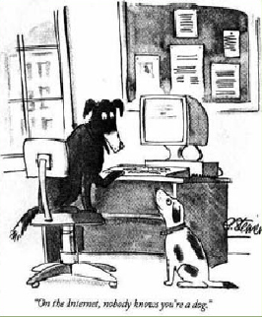
Getting Started
What you need:
A computer.
A web browser.
A place to house your page/s on the www
A program to upload the page to the home on the www
A word processor (preferably Windows Notepad or WordPad or MAC TextEdit or other text editing programs. NOT a text formatting program like Word.)
And you’re ready to make websites!

Slide 12
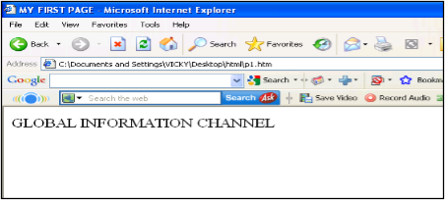
Code With HTML
<HTML>
<HEAD>
<TITLE>
MY FIRST PAGE
</TITLE>
</HEAD>
<BODY>
GLOBAL INFORMATION CHANNEL
</BODY>
</HTML>

Slide 13
Explain these tags
<HTML> - Describe HTML web page that is to be viewed by a web browser.
<HEAD> - This defines the header section of the page.
<TITLE> - This shows a caption in the title bar of the page.
<BODY> - This tag show contents of the web page will be displayed.

Slide 14
Types of HTML Tags
There are two different types of tags:->
Container Element:->
Container Tags contains start tag & end tag i.e.
<HTML>… </HTML>
Empty Element:->
Empty Tags contains start tag i.e.
<BR>

Slide 15
Text Formatting Tags
Heading Element:->
There are six heading elements (<H1>,<H2>,<H3>,<H4>, <H5>,<H6>).
All the six heading elements are container tag and requires a closing tag.
<h1> will print the largest heading
<h6> will print the smallest heading

Slide 16
Heading Tag Code
<html>
<head><title>heading</title></head>
<body>
<h1> GLOBAL INFO CHANNEL</h1>
<h2> GLOBAL INFO CHANNEL</h2>
<h3> GLOBAL INFO CHANNEL</h3>
<h4> GLOBAL INFO CHANNEL</h4>
<h5> GLOBAL INFO CHANNEL</h5>
<h6> GLOBAL INFO CHANNEL</h6>
</body>
</html>

Slide 17
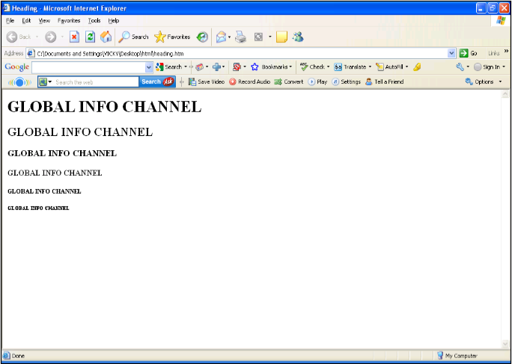
Result of Heading Code

Slide 18
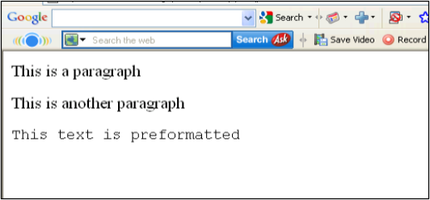
HTML Paragraph Tag
HTML documents are divided into paragraphs.
Paragraphs are defined with the <p> tag i.e.
<p>This is a paragraph</p> <p>This is another paragraph</p>
<pre>This text is preformatted</pre>

Slide 19
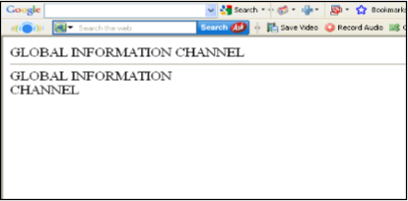
Line Break & Horizontal Line Tag
if you want a line break or a new line without starting a new paragraph Use the <br> tag.
Defines a horizontal line use <hr>tag.
<br> <hr> element are empty HTML element i.e. Global Information Channel<hr>
Global Information <br> Channel

Slide 20
Text Formatting Tags
Tag | Description
<b> | Defines bold text
<big> | Defines big text
<em> | Defines emphasized text
<i> | Defines italic text
<small> | Defines small text
<strong> | Defines strong text
<sub> | Defines subscripted text
<super> | Defines superscripted text
<ins> | Defines inserted text
<del> | Defines deleted text
<tt> | Defines teletype text
<u> | Defines underline text
<strike> | Defines strike text

Slide 21
Text Formatting Code
<html>
<head></head>
<body>
<b>This text is Bold</b>
<br><em>This text is Emphasized</em>
<br><i>This text is Italic</i>
<br><small>This text is Small</small>
<br>This is<sub> Subscript</sub> and <sup>Superscript</sup>
<br><strong>This text is Strong</strong>
<br><big>This text is Big</big>
<br><u>This text is Underline</u>
<br><strike>This text is Strike</strike>
<br><tt>This text is Teletype</tt>
</body>
</html>

Slide 22
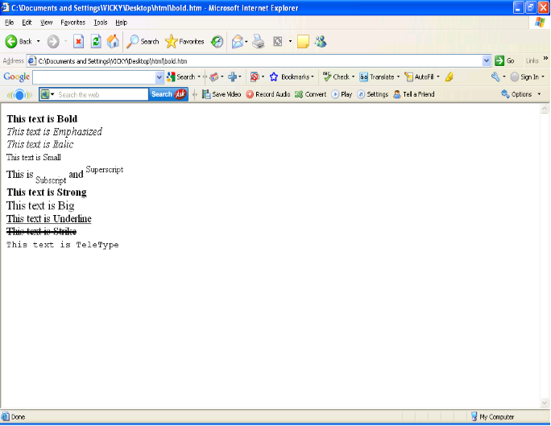
Result of Text Formatting Code

Slide 23
Font Tag
This element is used to format the size, typeface and color of the enclosed text.
The commonly used fonts for web pages are Arial, Comic Sans MS , Lucida Sans Unicode, Arial Black, Courier New, Times New Roman, Arial Narrow, Impact, Verdana.
The size attribute in font tag takes values from 1 to 7.

Slide 24
Font Tag Code
<html>
<head><title> fonts</title></head>
<body>
<br><font color=“green" size="7" face="Arial"> GLOBAL INFORMATION CHANNEL </font>
<br><font color=“green" size="6" face="Comic Sans MS "> GLOBAL INFORMATION CHANNEL </font>
<br><font color=“green" size="5" face="Lucida Sans Unicode"> GLOBAL INFORMATION CHANNEL </font>
<br><font color=“green" size="4" face="Courier New"> GLOBAL INFORMATION CHANNEL </font>
<br><font color=“green" size="3" face="Times New Roman"> GLOBAL INFORMATION CHANNEL </font>
<br><font color=“green" size="2" face="Arial Black"> GLOBAL INFORMATION CHANNEL </font>
<br><font color=“green" size="1" face="Impact"> GLOBAL INFORMATION CHANNEL </font>
</body>
</html>

Slide 25
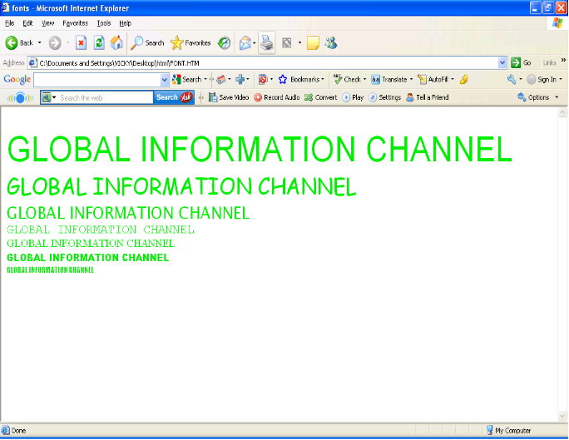
Result of Font Code

Slide 26
Single Tags
These tags do not require that you close them (in HTML only)
Tags | What it does
<hr> | Horizontal Line across the page
<br> | Inserts a new line
<img> | Adding an image

Slide 27
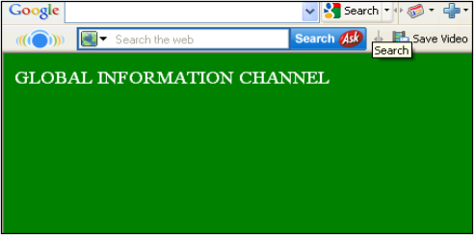
Background & Text Color Tag
The attribute bgcolor is used for changing the back ground color of the page.
<body bgcolor=“Green” >
Text is use to change the color of the enclosed text.
<body text=“White”>

Slide 28
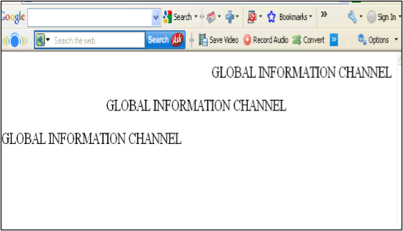
Text Alignment Tag
It is use to alignment of the text.
Left alignment <align=“left”>
Right alignment <align=“right”>
Center alignment <align=“center”>

Slide 29
Hyperlink Tag
A hyperlink is a reference (an address) to a resource on the web.
Hyperlinks can point to any resource on the web: an HTML page, an image, a sound file, a movie, etc.
The HTML anchor element <a>, is used to define both hyperlinks and anchors.
<a href="url">Link text</a>
The href attribute defines the link address.
<a href="http://www.google.com/">Visit Google home page!</a>

Slide 30
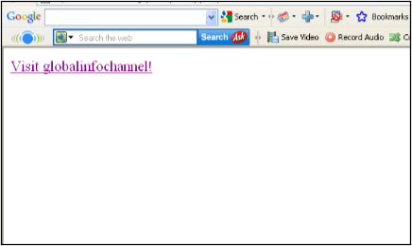

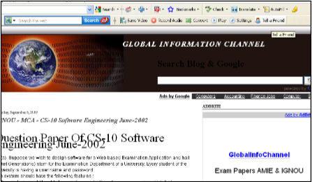
Result of Hyperlink Code

Slide 31
Image Tag
To display an image on a page, you need to use the src attribute.
src stands for "source". The value of the src attribute is the URL of the image you want to display on your page.
It is a empty tag.
<IMG SRC ="url">
<IMG SRC="picture.gif“>
<IMG SRC="picture.gif“ HEIGHT="30" WIDTH="50">

Slide 32
Image attributes - <img> tag
Tags /attribute | Definition
<img> | Defines an image
src | display an image on a page, Src stands for "source".
alt | Define "alternate text" for an image
width | Defines the width of the image
height | Defines the height of the image
Border | Defines the width of the image
Hspace | Horizontal space of the image
Vspace | Vertical space of the image
Align | Align an image within the text
background | Add a background image to an HTML page

Slide 33
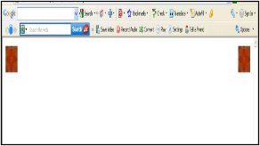
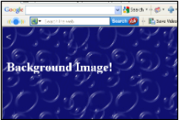
Code & Result of the Image
<html><body>
<p><img src="file:///C:/WINDOWS/Zapotec.bmp"
align="left" width="48" height="48"> </p>
<p><img src ="file:///C:/WINDOWS/Zapotec.bmp"
align="right" width="48" height="48"></p>
</body></html>
<HTML>
<<body background="file:///C:/WINDOWS/Soap%20Bubbles.bmp" text="white">
<br><br><br>
<h2> Background Image!</h2>
</BODY></HTML>

Slide 34
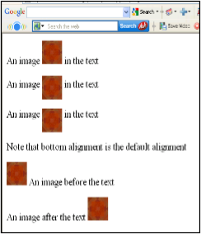
Code & Result of the Image
<html><body>
<p>An image
<img src="file:///C:/WINDOWS/Zapotec.bmp"
align="bottom" width="48" height="48"> in the text</p>
<p>An image
<img src ="file:///C:/WINDOWS/Zapotec.bmp"
align="middle" width="48" height="48"> in the text</p>
<p>An image
<img src ="file:///C:/WINDOWS/Zapotec.bmp"
align="top" width="48" height="48"> in the text</p>
<p>Note that bottom alignment is the default alignment</p>
<p><img src ="file:///C:/WINDOWS/Zapotec.bmp"
width="48" height="48">
An image before the text</p>
<p>An image after the text
<img src ="file:///C:/WINDOWS/Zapotec.bmp"
width="48" height="48"> </p>
</body></html>

Slide 35
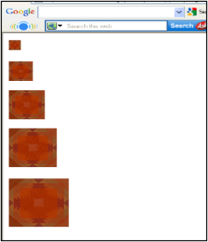
Code & Result of the Image
<html><body>
<p><img src="file:///C:/WINDOWS/Zapotec.bmp"
align="bottom" width="20" height="20"> </p>
<p><img src ="file:///C:/WINDOWS/Zapotec.bmp"
align="middle" width="40" height="40"></p>
<p><img src ="file:///C:/WINDOWS/Zapotec.bmp"
align="top" width="60" height="60"></p>
<p><img src ="file:///C:/WINDOWS/Zapotec.bmp"
width="80" height="80"> </p>
<p><img src ="file:///C:/WINDOWS/Zapotec.bmp"
width="100" height="100"> </p>
</body></html>

Slide 36
HTML Table Tag
<table> | used to create table
<tr> | table is divided into rows
<td> | each row is divided into data cells
<th> | Headings in a table
<Caption> | caption to the table
<colgroup> | Defines groups of table columns
<col> | Defines the attribute values for one or more columns in a table
<thead> | Defines a table head
<tbody> | Defines a table body
<tfoot> | Defines a table footer
<cellspacing> | amount of space between table cells
<cellpadding> | space around the edges of each cell
<colspan> | No of column working with will span
<rowspan> | No of rows working with will span
border | attribute takes a number

Slide 37
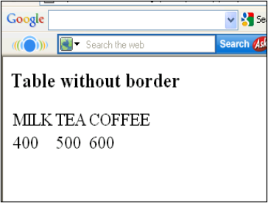
Code & Result of the Table
<html>
<body>
<h3>Table without border</h3>
<table>
<tr> <td>MILK</td>
<td>TEA</td>
<td>COFFEE</td> </tr>
<tr> <td>400</td>
<td>500</td>
<td>600</td> </tr>
</table>
</body>
</html>

Slide 38
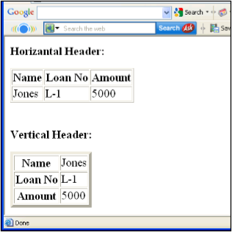
Table Code with Border & Header
<html><body>
<h4>Horizontal Header:</h4>
<table border="1">
<tr> <th>Name</th>
<th>Loan No</th>
<th>Amount</th> </tr>
<tr> <td>Jones</td>
<td>L-1</td>
<td>5000</td></tr> </table><br><br>
<h4>Vertical Header:</h4>
<table border="5">
<tr> <th>Name</th>
<td>Jones</td> </tr>
<tr> <th>Loan No</th>
<td>L-1</td> </tr>
<tr> <th>Amount</th>
<td>5000</td></tr> </table>
</body></html>

Slide 39
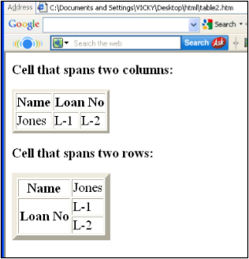
Table Code with Colspan & Rowspan
<html><body>
<h4>Cell that spans two columns:</h4>
<table border="4">
<tr> <th>Name</th>
<th colspan="2">Loan No</th> </tr>
<tr> <td>Jones</td>
<td>L-1</td>
<td>L-2</td> </tr> </table>
<h4>Cell that spans two rows:</h4>
<table border="8">
<tr> <th>Name</th>
<td>Jones</td></tr><tr>
<th rowspan="2">Loan No</th>
<td>L-1</td></tr><tr>
<td>L-2</td></tr></table>
</body></html>

Slide 40
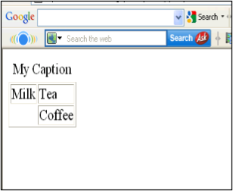
Table Code with Caption & Col Spacing
<html>
<body>
<table border="1">
<caption>My Caption</caption>
<tr>
<td>Milk</td>
<td>Tea</td>
</tr>
<tr>
<td></td>
<td>Coffee</td>
</tr>
</table>
</body>
</html>

Slide 41
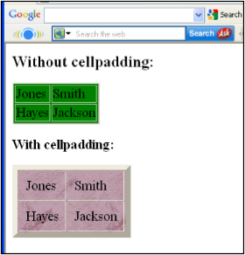
Cell padding, Image & Back color Code
<html><body>
<h3>Without cellpadding:</h3>
<table border="2" bgcolor="green">
<tr> <td>Jones</td>
<td>Smith</td></tr>
<tr> <td>Hayes</td>
<td>Jackson</td></tr></table>
<h4>With cellpadding:</h4>
<table border="8"
cellpadding="10" background="file:///C:/WINDOWS/FeatherTexture.bmp">
<tr> <td>Jones</td>
<td>Smith</td></tr>
<tr> <td>Hayes</td>
<td>Jackson</td></tr></table>
</body></html>

Slide 42
HTML List Tag
Lists provide methods to show item or element sequences in document content. There are three main types of lists:->
Unordered lists:-unordered lists are bulleted
Ordered lists:- Ordered lists are numbered
Definition lists:- Used to create a definition list

Slide 43
List Tags
<LI> | <LI> is an empty tag, it is used for representing the list items
<OL> | Ordered list
<UL> | Unordered list
<DL> | Defines a definition list
<DT> | Defines a term (an item) in a definition list
<DD> | Defines a description of a term in a definition list

Slide 44
Unordered List
TYPE attribute to the <UL> tag to show different bullets like:-
Disc
Circle
Square
<ul Type =“disc”>…..</ul>
The attribute TYPE can also be used with <LI> element.

Slide 45
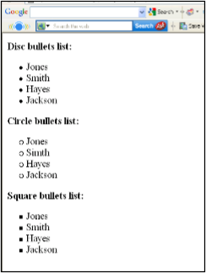
Code & Result of the Unordered List
<html><body>
<h4>Disc bullets list:</h4>
<ul type="disc"> <li>Jones</li>
<li>Smith</li>
<li>Hayes</li>
<li>Jackson</li></ul>
<h4>Circle bullets list:</h4>
<ul type="circle"> <li>Jones</li>
<li>Simth</li>
<li>Hayes</li>
<li>Jackson</li></ul>
<h4>Square bullets list:</h4>
<ul type="square"> <li>Jones</li>
<li>Smith</li>
<li>Hayes</li>
<li>Jackson</li></ul>
</body></html>

Slide 46
Ordered List
The TYPE attribute has the following value like:-
TYPE = "1" (Arabic numbers)
TYPE = "a" (Lowercase alphanumeric)
TYPE = "A" (Uppercase alphanumeric)
TYPE = "i" (Lowercase Roman numbers)
TYPE = "I" (Uppercase Roman numbers)
By default Arabic numbers are used

Slide 47
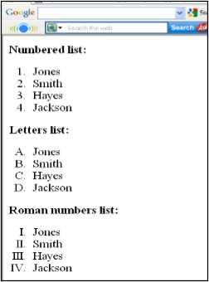
Code & Result of the Ordered List
<html><body>
<h4>Numbered list:</h4>
<ol> <li>Jones</li>
<li>Smith</li>
<li>Hayes</li>
<li>Jackson</li></ol>
<h4>Letters list:</h4>
<ol type="A"> <li>Jones</li>
<li>Smith</li>
<li>Hayes</li>
<li>Jackson</li></ol>
<h4>Roman numbers list:</h4>
<ol type="I"> <li>Jones</li>
<li>Smith</li>
<li>Hayes</li>
<li>Jackson</li></ol>
</body></html>

Slide 48
HTML Form
A form is an area that can contain form elements.
Form elements are elements that allow the user to enter information in a form. like text fields, textarea fields, drop-down menus, radio buttons and checkboxes etc
A form is defined with the <form> tag.
The syntax:-
<form> . input elements . </form>

Slide 49
Form Tags
<form> | Defines a form for user input
<input> | used to create an input field
<text> | Creates a single line text entry field
<textarea> | Defines a text-area (a multi-line text input control)
<password> | Creates a single line text entry field. And the characters entered are shown as asterisks (*)
<label> | Defines a label to a control
<option> | Creates a Radio Button
<select> | Defines a selectable list (a drop-down box)
<button> | Defines a push button
<value> | attribute of the option element
<checkbox> | select or unselect a checkbox
<dropdown box> | A drop-down box is a selectable list

Slide 50
Code of the HTML Form
<html><body><form>
<h1>Create a Internet Mail Account</h1>
<p>First Name <input type="text" name="T1" size="30"></p>
<p>Last Name <input type="text" name="T2" size="30"></p>
<p>Desired Login Name <input type="text" name="T3" size="20">
@mail.com</p>
<p>Password <input type="password" name="T4" size="20"></p>
<input type="radio" checked="checked" name="sex" value="male" /> Male</br>
<input type="radio" name="sex" value="female" /> Female
<p>Birthday <input type="text" name="T6" size="05">
<select size="1" name="D2">
<option>-Select One-</option>
<option>January</option>
<option>February</option>
<option>March</option> </select>
<input type="text" name="T7" size="10"></p>
TypeYourself<textarea rows="4" name="S1" cols="20"></textarea>
<br><input type="submit" value="Accept" name="B1"> <input type="reset“ value="Cancel“
name="B2"></br> </form></body></html>

Slide 51
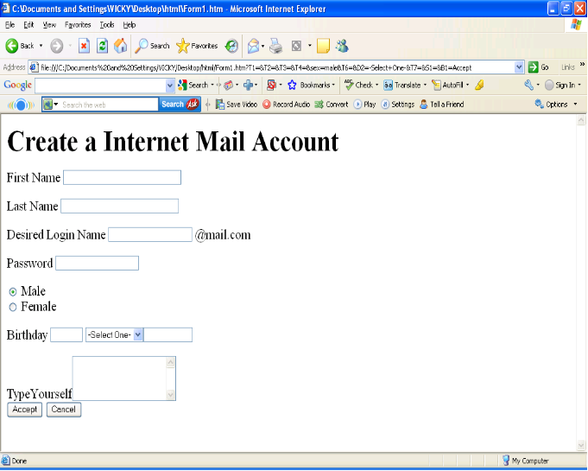
Result of the Form Code

